Slide 1





Analytical Study for Automobile Re-Seller
Aryan Patil
23f1000968@ds.study.iitm.ac.in
Business: New My Choice Cars, Pimpri–Pune

Slide 2


ABOUT THE BUSINESS
New My Choice Cars is a pre-owned automobile resale dealership located in Pimpri, Pune.
The business operates primarily in B2C (selling vehicles to end customers) and C2B (buying vehicles from individuals).
The dealership deals in multiple segments such as SUVs, Hatchbacks, Sedans and MUVs.
All transactions are recorded using physical “Kararnama” agreements, making tracking and analysis difficult without digitization.

Slide 3
CHALLENGES IDENTIFIED
Manual record-keeping on physical agreements makes it difficult to track sales performance and demand patterns.
No structured method to identify peak months / peak weekdays, affecting staffing and planning.
Lack of clear insights on vehicle type demand (SUV vs Sedan etc.), price segment demand, and payment/financing behavior.
Need to convert raw records into a repeatable Excel-based analysis system usable by the business owner.

Slide 4

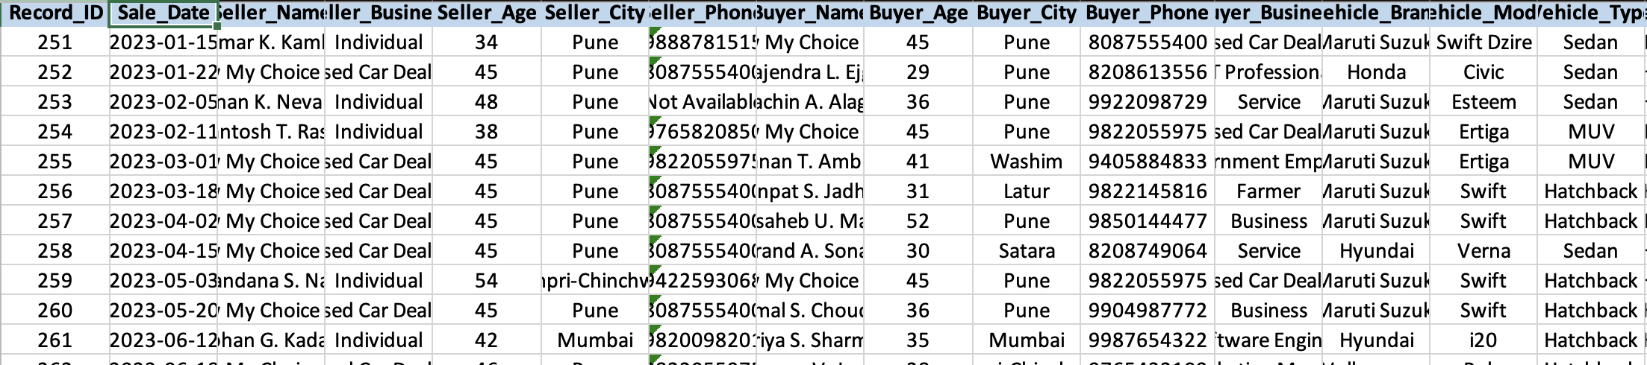


DATA
OVERVIEW
Source: Physical transaction agreements (Kararnama documents) from New My Choice Cars
Dataset size: 91 transactions
Data captured: Transaction Date, Vehicle Type, Sale Amount, Price Band, Payment Mode, etc.
Data entry and verification was done manually from physical records into Excel
Tools used: Excel (main) for cleaning, derived columns, pivot tables and charts
To tackle these challenges following data was collected from the period 15 Jan, 2023 to 11 Oct, 2025

Slide 5
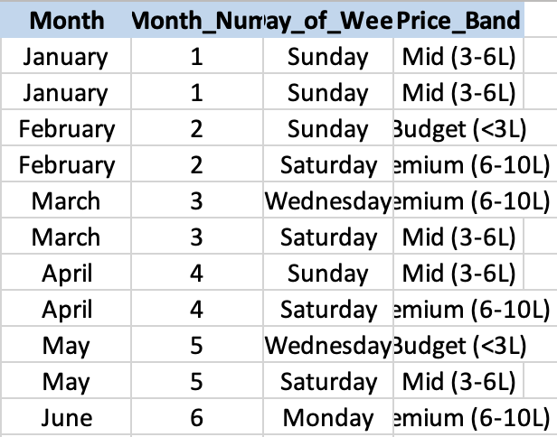
DATA CLEANING & PRE-PROCESSING
Standardized brand/type naming to avoid duplicates due to spelling variations
Converted dates into a consistent format to enable monthly and weekday analysis
Verified sale values and corrected inconsistent entries
Created derived fields:
Month (for seasonal trend)
Day of Week (for weekly business cycle)
Price Band (Budget / Mid / Premium / Luxury)

Slide 6
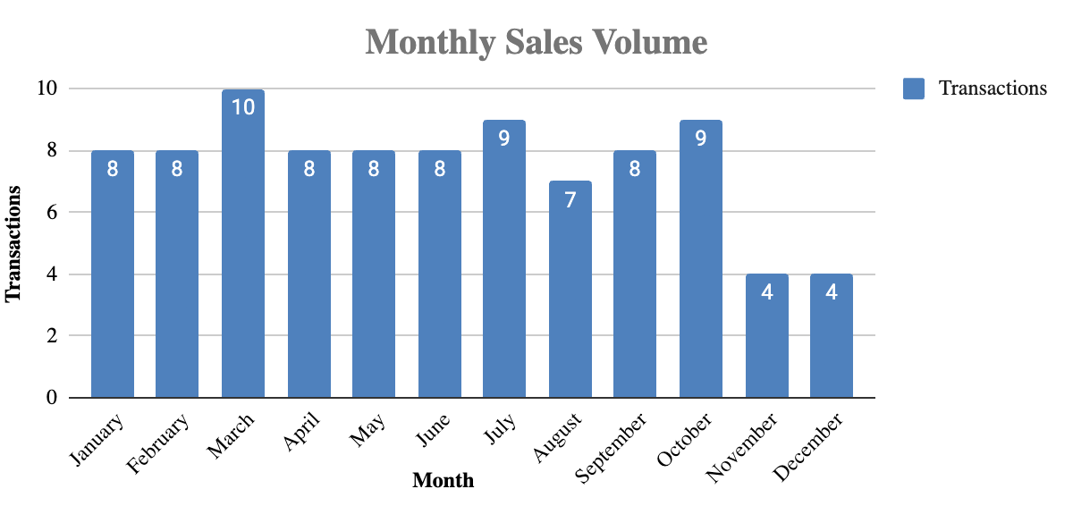
MONTHLY SALES PERFOMANCE
Sales are not uniform across the year and show clear seasonal variation
Peak performance observed during March, July and October
Lowest transaction activity observed in November and December
Business implication: Inventory procurement should be planned before peak months and year-end clearance can reduce slow movement

Slide 7
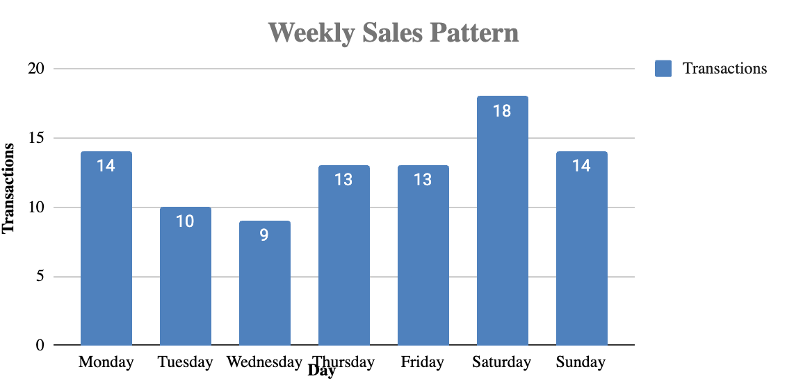
WEEKLY BUSINESS CYCLE
Transactions are highest on Saturday (peak day)
Weekend demand is strong and often extends into Sunday and Monday
Business implication: Staffing and documentation support should be highest during weekend peak load to avoid delays and missed conversions

Slide 8
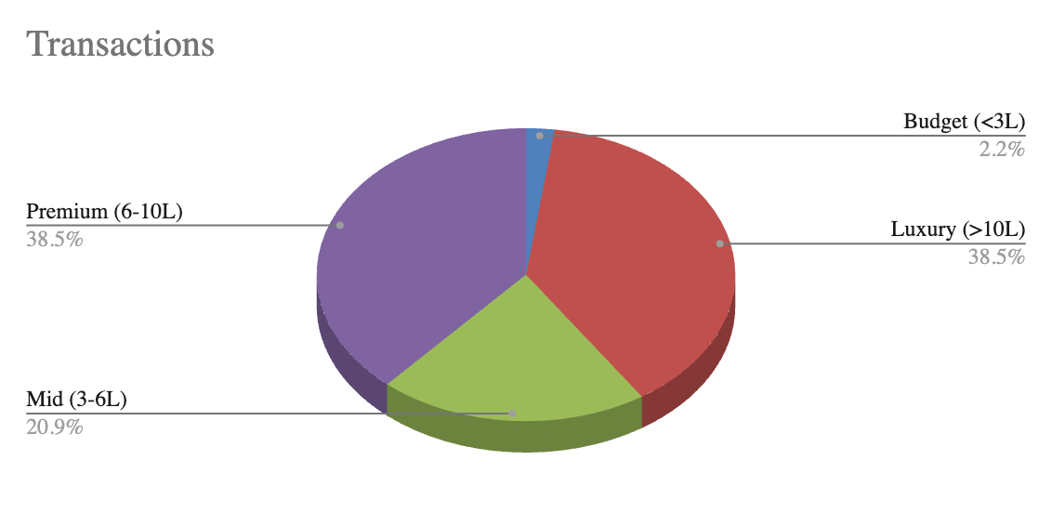
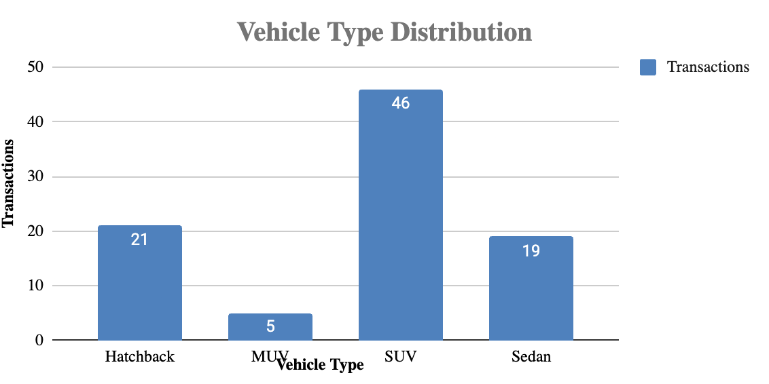
MARKET SEGMENT INSIGHTS
SUVs dominate the sales mix, indicating strong customer preference for this category
Majority transactions fall under Premium (₹6–10L) and Luxury (>₹10L) segments
Business implication: Focus procurement on fast-moving SUV models and maintain premium inventory positioning instead of budget-heavy stock

Slide 9
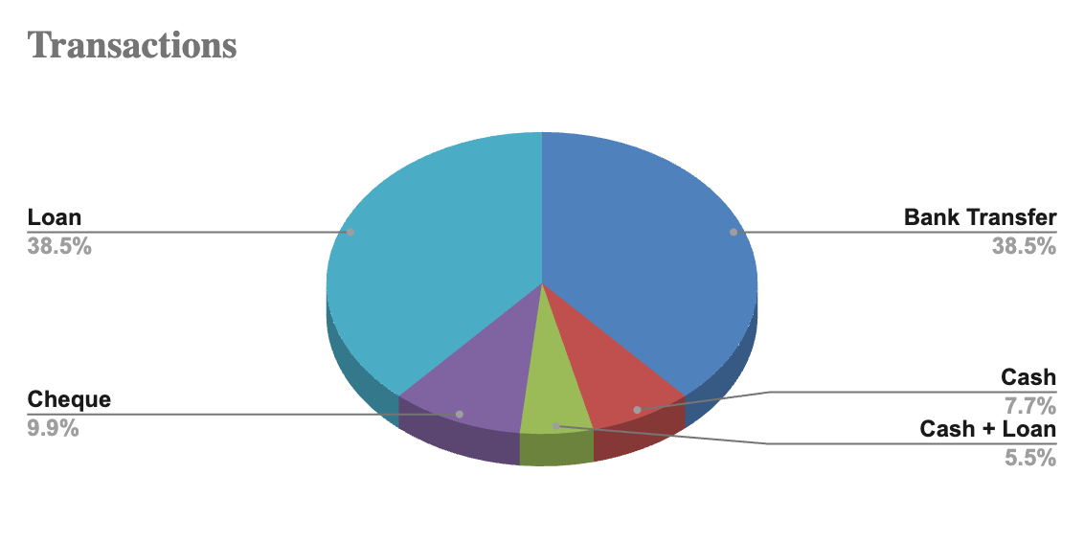
PAYMENT MODE INSIGHTS
Majority transactions are completed via Loans and Bank Transfers
Cash and cheque transactions are comparatively lower
Business implication: Strong dependence on financing partners → faster loan processing improves conversion and customer experience

Slide 10
KEY RECOMMENDATIONS
Continue Doing
Maintain focus on SUV segment and premium/luxury inventory
Continue supporting bank-mediated transactions (loan + transfer)
Start Doing
Implement peak-day staffing (Saturday–Monday)
Run year-end clearance offers to improve Nov–Dec sales
Build preferred partnerships with 2–3 banks/NBFCs for faster approvals
Avoid Doing
Avoid over-investing in Budget (<₹3L) vehicles
Avoid bulk procurement of MUVs unless demand is confirmed
Conclusion: Excel-based analysis framework provides a repeatable system for decision-making in inventory, operations, and financing.

